Slide 1
The EO Processing Chain: Scatterometry As An Example
Simon Kok Lupemba
Junior remote sensing scientist
JuliaEO24 11/01/2024

Slide 2
Agenda
Introduction to EUMETSAT.
The EO processing chain, scatterometry as an example.
How we use Julia in my team.
My personal view on Julia for EO processing.

Slide 3

Agenda
Introduction to EUMETASAT.
The EO processing chain, scatterometry as an example.
How we use Julia in my team.
My personal view on Julia for EO processing.

Slide 4

An intergovernmental organisation with 30 member states
AUSTRIA
BELGIUM
BULGARIA
CROATIA
CZECHIA
DENMARK
ESTONIA
FINLAND
FRANCE
GERMANY
GREECE
HUNGARY
ICELAND
IRELAND
ITALY
LATVIA
LITHUANIA
LUXEMBOURG
THE NETHERLANDS
NORWAY
POLAND
PORTUGAL
ROMANIA
SLOVAK REPUBLIC
SLOVENIA
SPAIN
SWEDEN
SWITZERLAND
TURKEY
UNITED KINGDOM

Slide 5

EUMETSAT mission
Primary objective:
Establish, maintain and exploit European systems of meteorological satellites.
Further objective:
Contribute to the operational monitoring of the climate and the detection of global climatic changes.

Slide 6
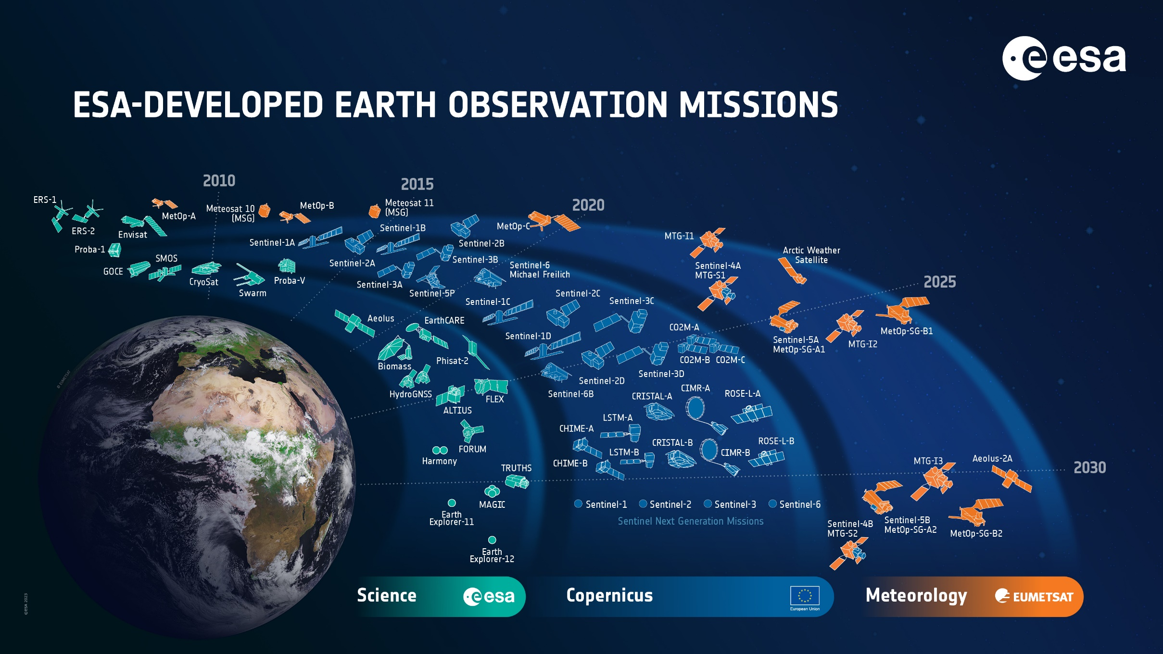
European EO missions

Slide 7
EUMETSAT mission planning
MANADATORY PROGRAMME
SATELLITE
2020
2025
2030
2035
2040
2045
2050
Meteosat Second Generation (MSG)
Meteosat-8
Meteosat-9
Meteosat-10
Meteosat-11
Meteosat Third Generation (MTG)
MTG-I1
MTG-S1
MTG-I2
MTG-I3
MTG-S2
MTG-I4
EUMETSAT Polar System (EPS)
Metop-A
Metop-B
Metop-C
EUMETSAT Polar System - Second Generation
(EPS-SG)
Metop-SGA1
Metop-SGB1
Metop-SGA2
Metop-SGB2
Metop-SGA3
Metop-SGB3
OPTIONAL AND COPERNICUS PROGRAMME
Jason
Jason-3
Copernicus
Sentinel-3A
Sentinel-3B
Sentinel-3C
Sentinel-3D
Sentinel-6 Michael Freilich
Sentinel-6B
Sentinel-6C
Sentinel-6 NG
CRISTAL
CO2M

Slide 8
Agenda
Introduction to EUMETASAT.
The EO processing chain, scatterometry as an example.
How we use Julia in my team.
My personal view on Julia for EO processing.

Slide 9
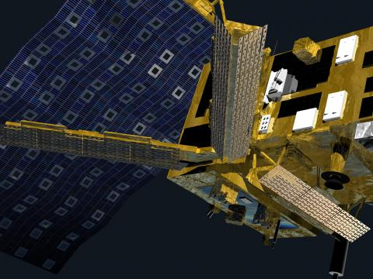
Advanced SCATterometer (ASCAT) - METOP

Slide 10
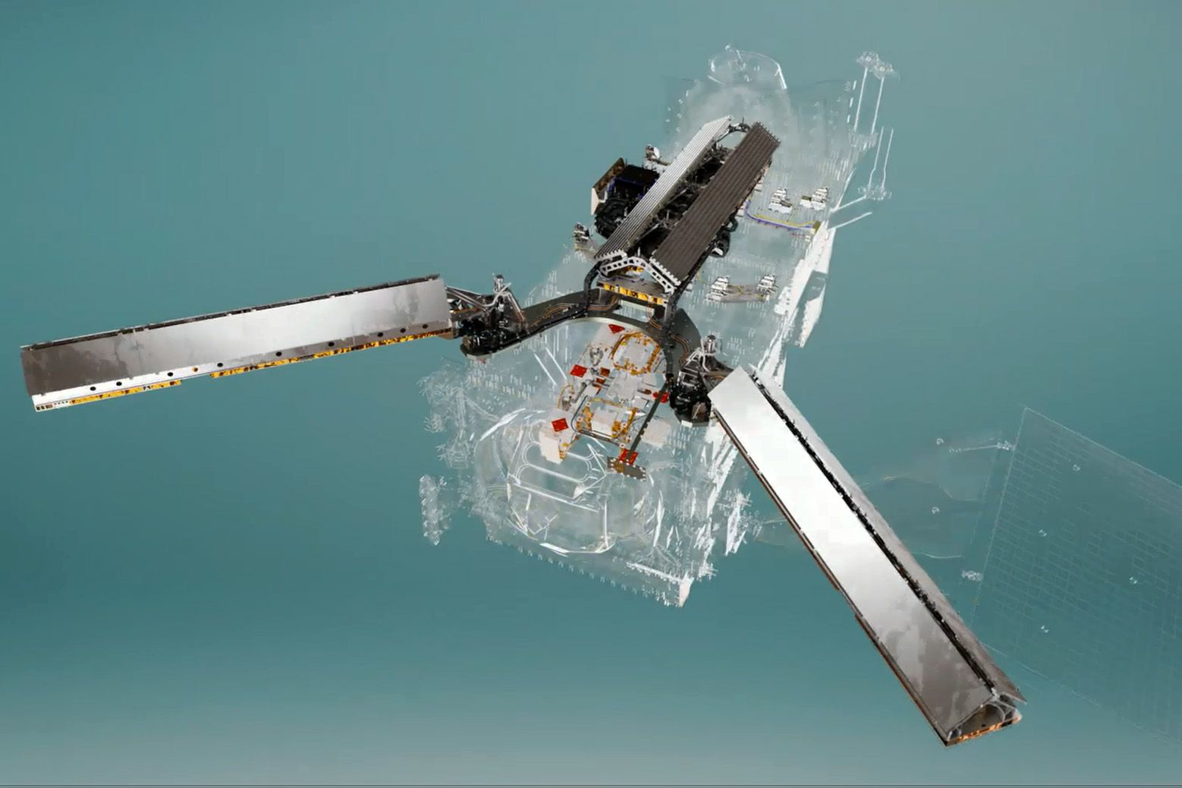
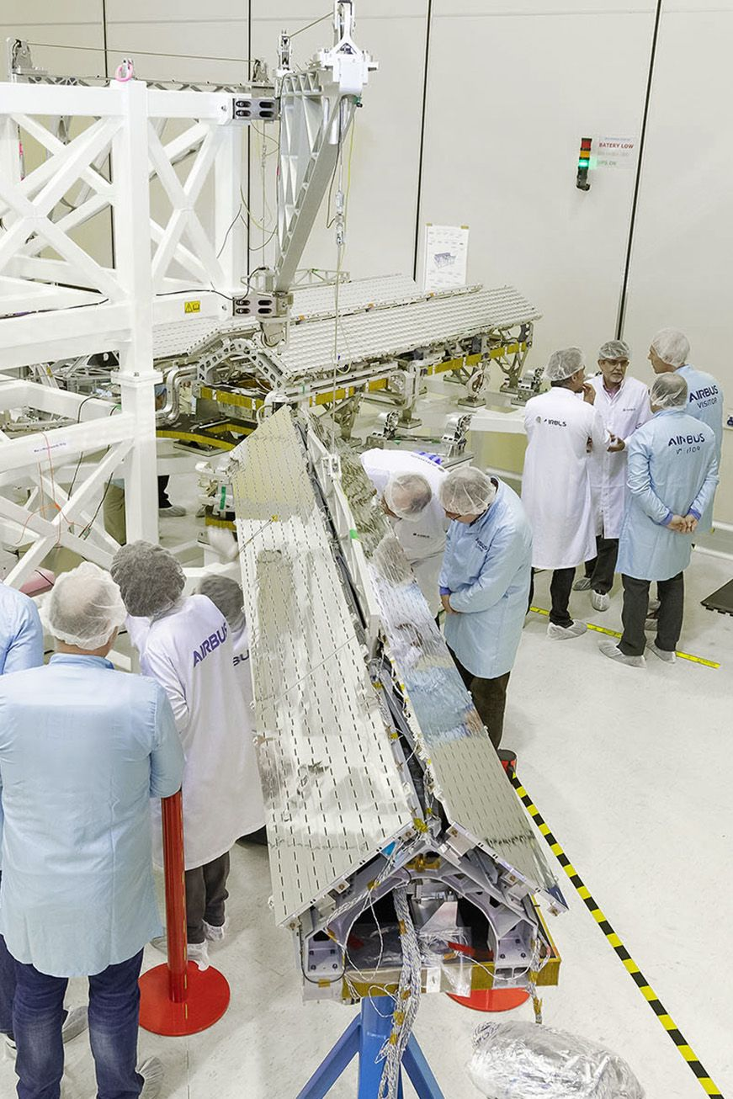
Scatterometer (SCA) – METOP Second Generation
© Airbus
© Airbus

Slide 11
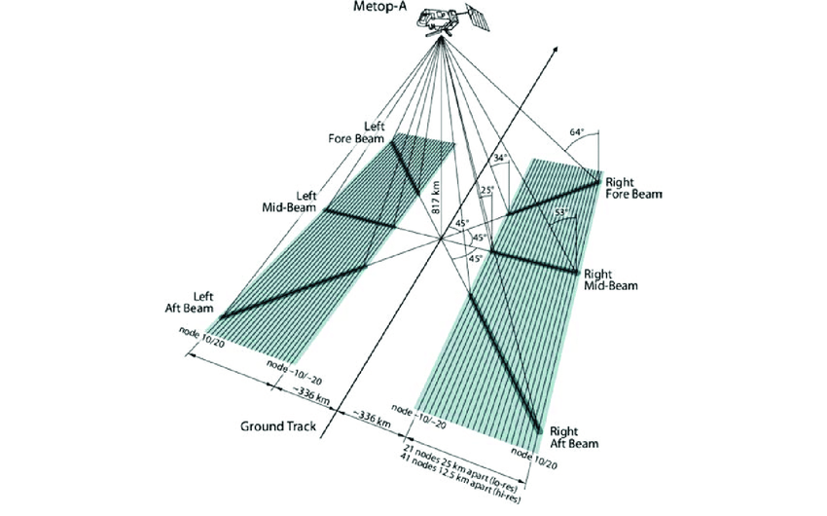
Side looking radar

Slide 12
Data Processing Levels
Used by NASA, ESA, EUMETSAT and more.
Level 0: Raw instrument data
Level 1: Radiometrically and geometrically calibrated geo-located data.
Level 2: Derived geophysical variables.

Slide 13

Overview of processing chain
Near Real Time Dissemination
L1 Processor
L2 Processor
Level 0
Level 1
Level 2
Data Store and Archive

Slide 14
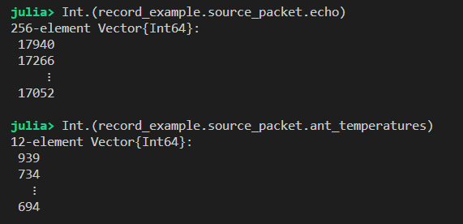
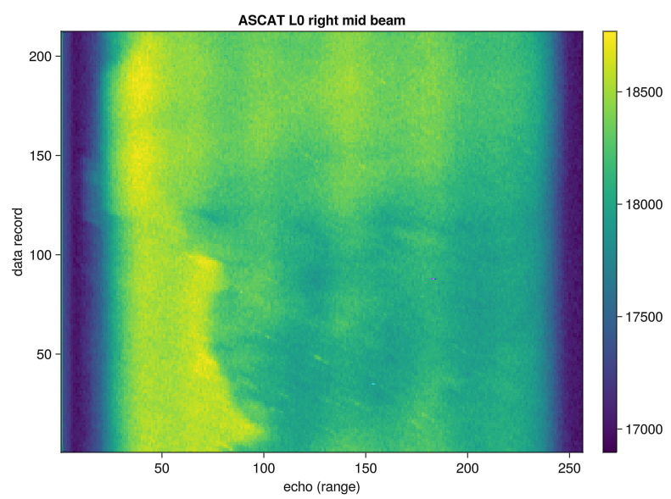
Level 0 – Instrument data
Comes in data records.
Contains antenna id, echo, noise measurements, internal temperatures and more.
Only dimension is time from the internal clock
Everything is in unsigned integers. No units
Data rate.
ASCAT ~5 kB/s, ~20 MB/h (On board averaging)
SCA ~ 1.2 MB/s, ~ 4.25 GB/h (No on-board averaging)

Slide 15
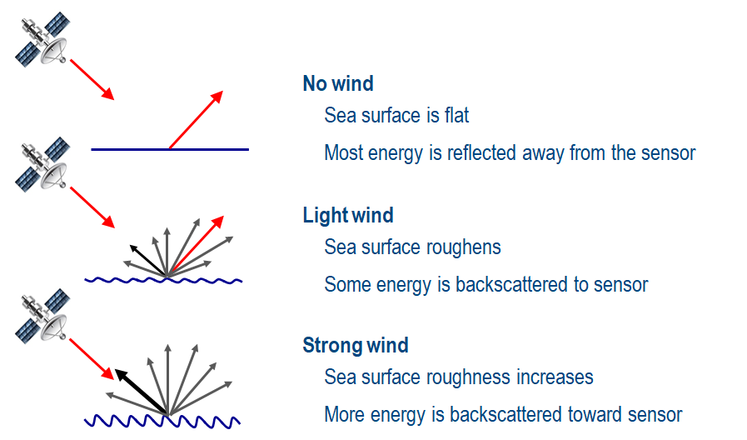
Level 1 – Geolocated backscatter
Credit: https://coastwatch.gitbook.io/satellite-course/lectures/ocean-surface-winds

Slide 16
Level 1 processing
Geolocate using orbit state and data record timestamps (leap seconds matter).
Use Aux files to convert echo to Radiometrically calibrated backscattering coefficients.
Add quality flags.
Compute resampled products.
Aux files
Level 0
L1 Processor
Level 1
Orbit State

Slide 17
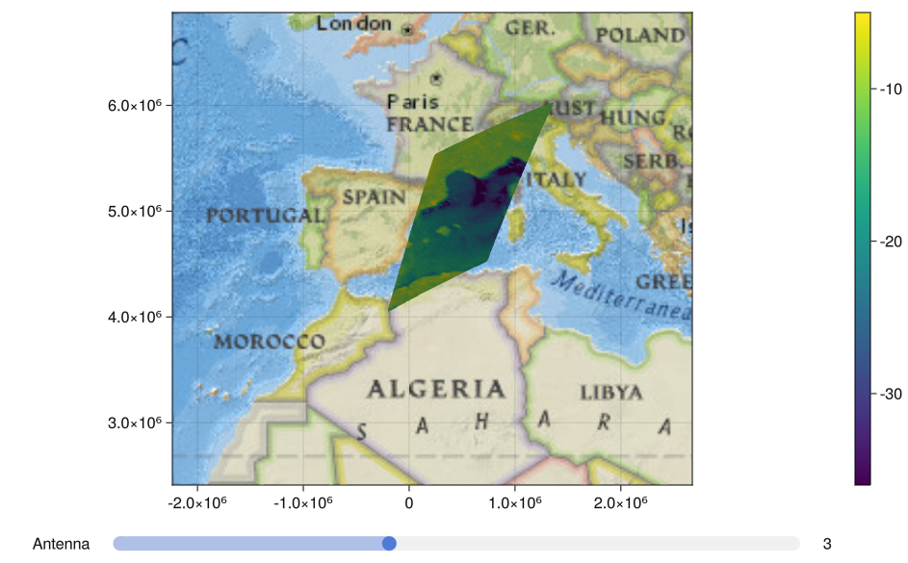
SZF Makie demo

Slide 18
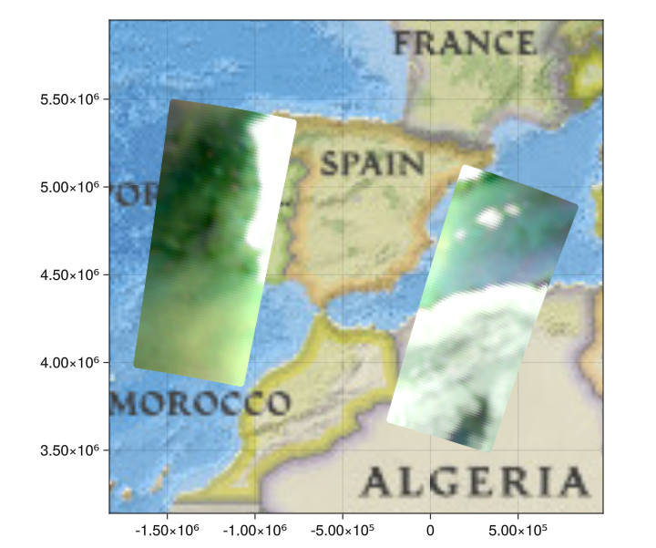
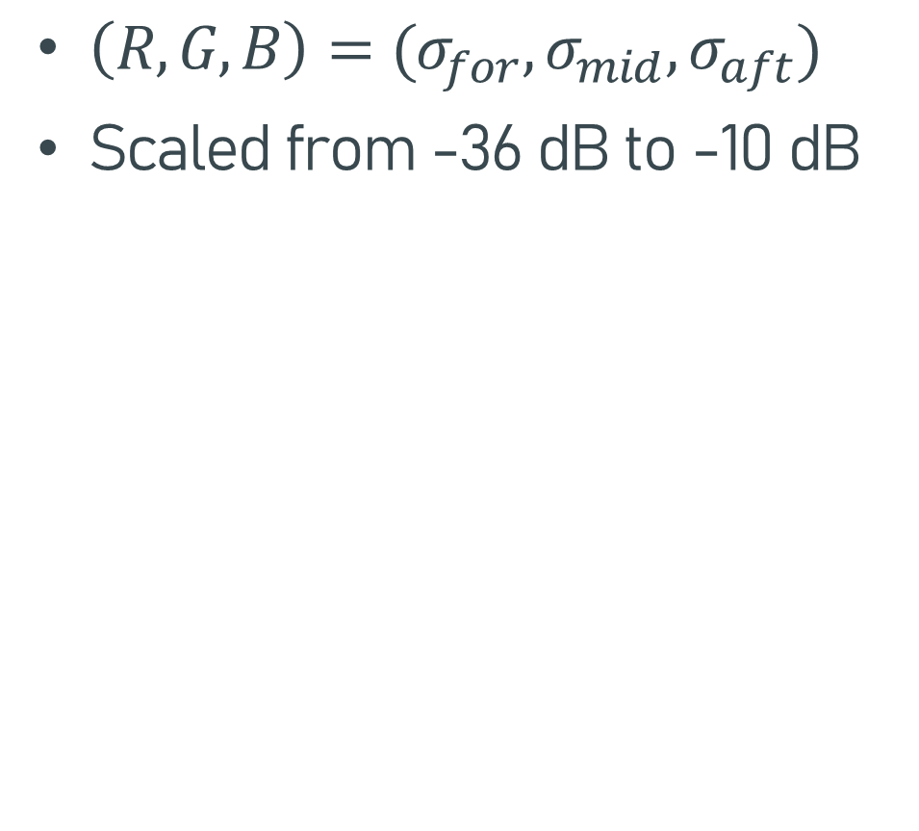
SZR Makie demo
$\left(R,G,B\right)=(σ_{for},σ_{mid},σ_{aft})$
Scaled from -36 dB to -10 dB

Slide 19
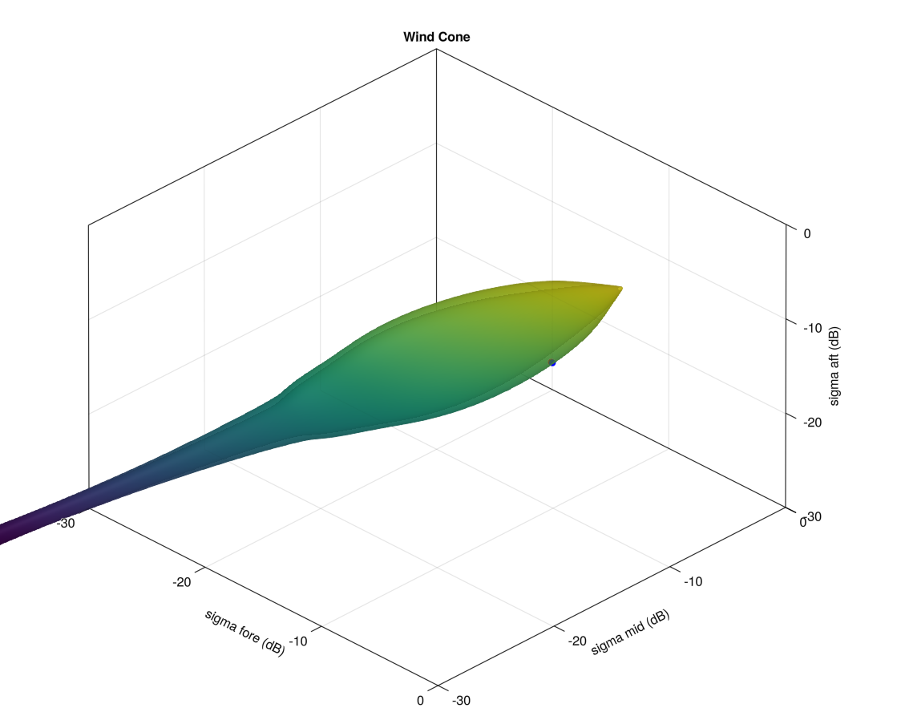
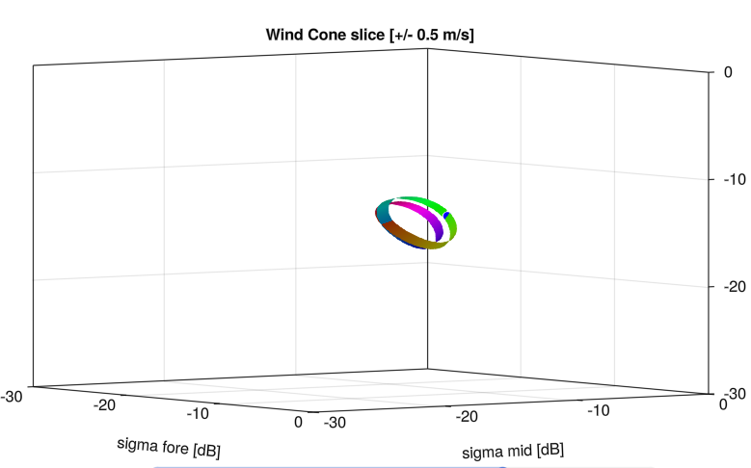
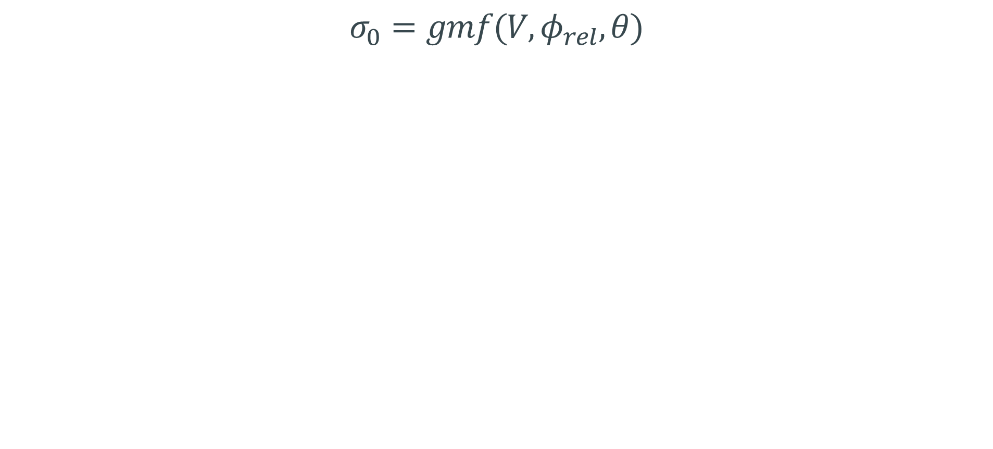
Level 2 – Winds Geophysical model (KNMI)
$σ_{0}=gmf(V,φ_{rel},θ)$

Slide 20
Level 2 – Processing Wind
Done by OSI-SAF.
Estimate wind speed and direction based on level 1 backscatter.
Only over ocean.
Ambiguities corrections.
Distance to model function.
Quality flag.

Slide 21
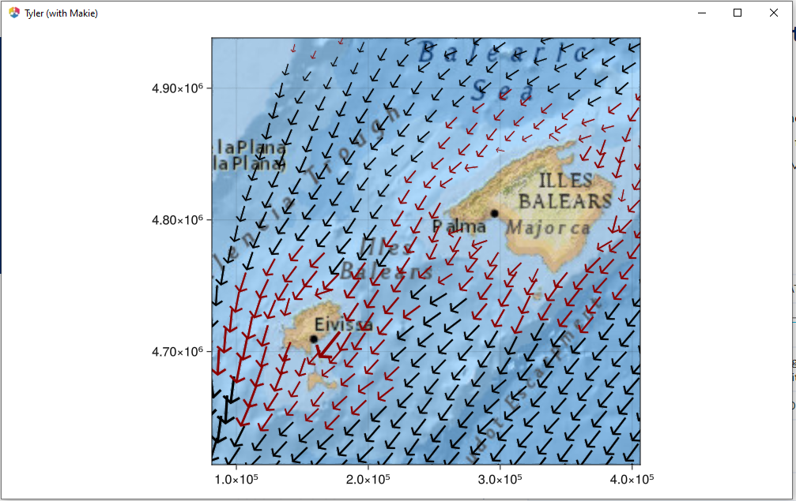
Winds Makie demo

Slide 22
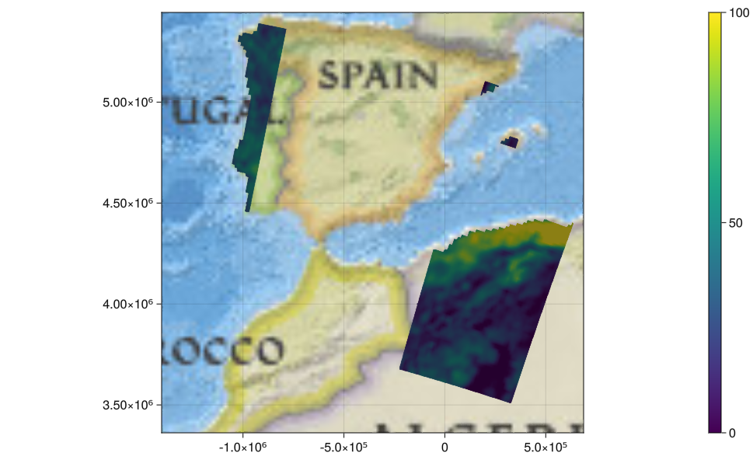
Soil moisture Makie demo

Slide 23
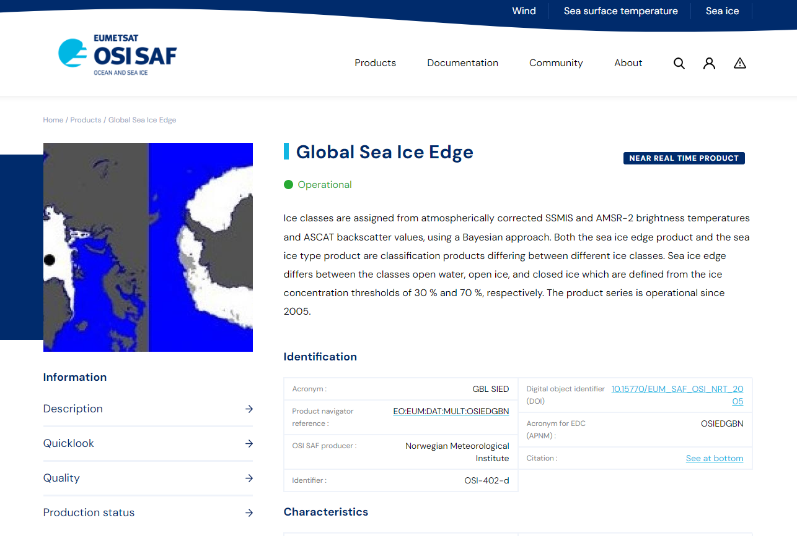
Beyond level 2
Not my area of expertise.
Fusion products.
Interpolations.
More complex products.

Slide 24
Agenda
Introduction to EUMETASAT.
The EO processing chain, scatterometry as an example.
How we use Julia in my team.
My personal view on Julia for EO processing.

Slide 25
What is Julia used for at EUMETSAT
Julia is a niche at EUMETSAT
Visualisation
Monitoring of science data
Tools for calibration
Regression testing
Prototyping
Julia is not used in the operational processing chain

Slide 26
Agenda
Introduction to EUMETASAT.
The EO processing chain, scatterometry as an example.
How we use Julia in my team.
My personal view on Julia for EO processing.

Slide 27
My personal view on Julia for EO processing.
Opportunities
High performance scientific computing.
Composability via package could improve reusability.
More open source.
Flexible data types.
Potential in the whole chain. From L0 processing to large weather models.
Challenges
EUMETSATS is not a first mover (Long operational programs).
Awareness.
Industry uptake.
Maturity.
Open source vs proprietary information.

Slide 28
My personal view on Julia for EO processing.
The road forward.
I hope to publish AscatData.jl.
Contribute to open source packages relevant for EUMETSAT.
Prove the value of Julia through non-operational tools.
Keep an eye out for first movers.
Advocate for Julia at EUMETSAT.

Slide 29

Engage
Use the data. https://data.eumetsat.int/
EUMETSAT Meteorological Satellite Conference 2024
I hope to see Julia users at the conference.
Early Career Scientists Initiative (Under 32 and under 2 years work experience)

Slide 30
Thank you!
Questions are welcome.

